Slide 1
Mental Health Counseling Mobile Office Space
Bret Burkes, Kristen Henderson, Edwin Perez, Danielle Yamson
CENE-486C Presentation
April 26, 2019

Slide 2
Project Introduction
Purpose
Design a mobile office that can be utilized as a mental health consultation area
Client
A Licensed Professional Counselor
Location
The mobile office will operate mostly in Yavapai and Coconino County
Background
Design an office space to provide health counseling for those without the abilities of transportation

Slide 3
Project Constraints/Criteria
$50,000 budget
Solar Panels
Removable Panels
Main source of power
Zero use of propane or gas
Composting Toilet System
Sound-proof Counseling Room
Removable Wall between Counseling Room and Waiting Area
Determine which Construction and Design Codes to follow
Last minute client request: shorten the trailer length

Slide 4
Design standards
Federal Motor Vehicle Standards
National Fire Protection Association 70 (NFPA 70) Electrical Standards
American National Standards Institute for Recreational Vehicles
International Building Code (IBC)
National Design Specification for Wood Construction
Special Design Provisions for Wind & Seismic
Arizona Department of Transportation (ADOT) Standards

Slide 5
Project impacts
Social:
Clients who do not have access to mental health consultation in their area will now be offered that option
Economical:
Client is able to travel for business and reach out to more clients
Environmental:
Less gas emissions by reducing the amount of travel done by the clients

Slide 6
Architectural plan

Slide 7
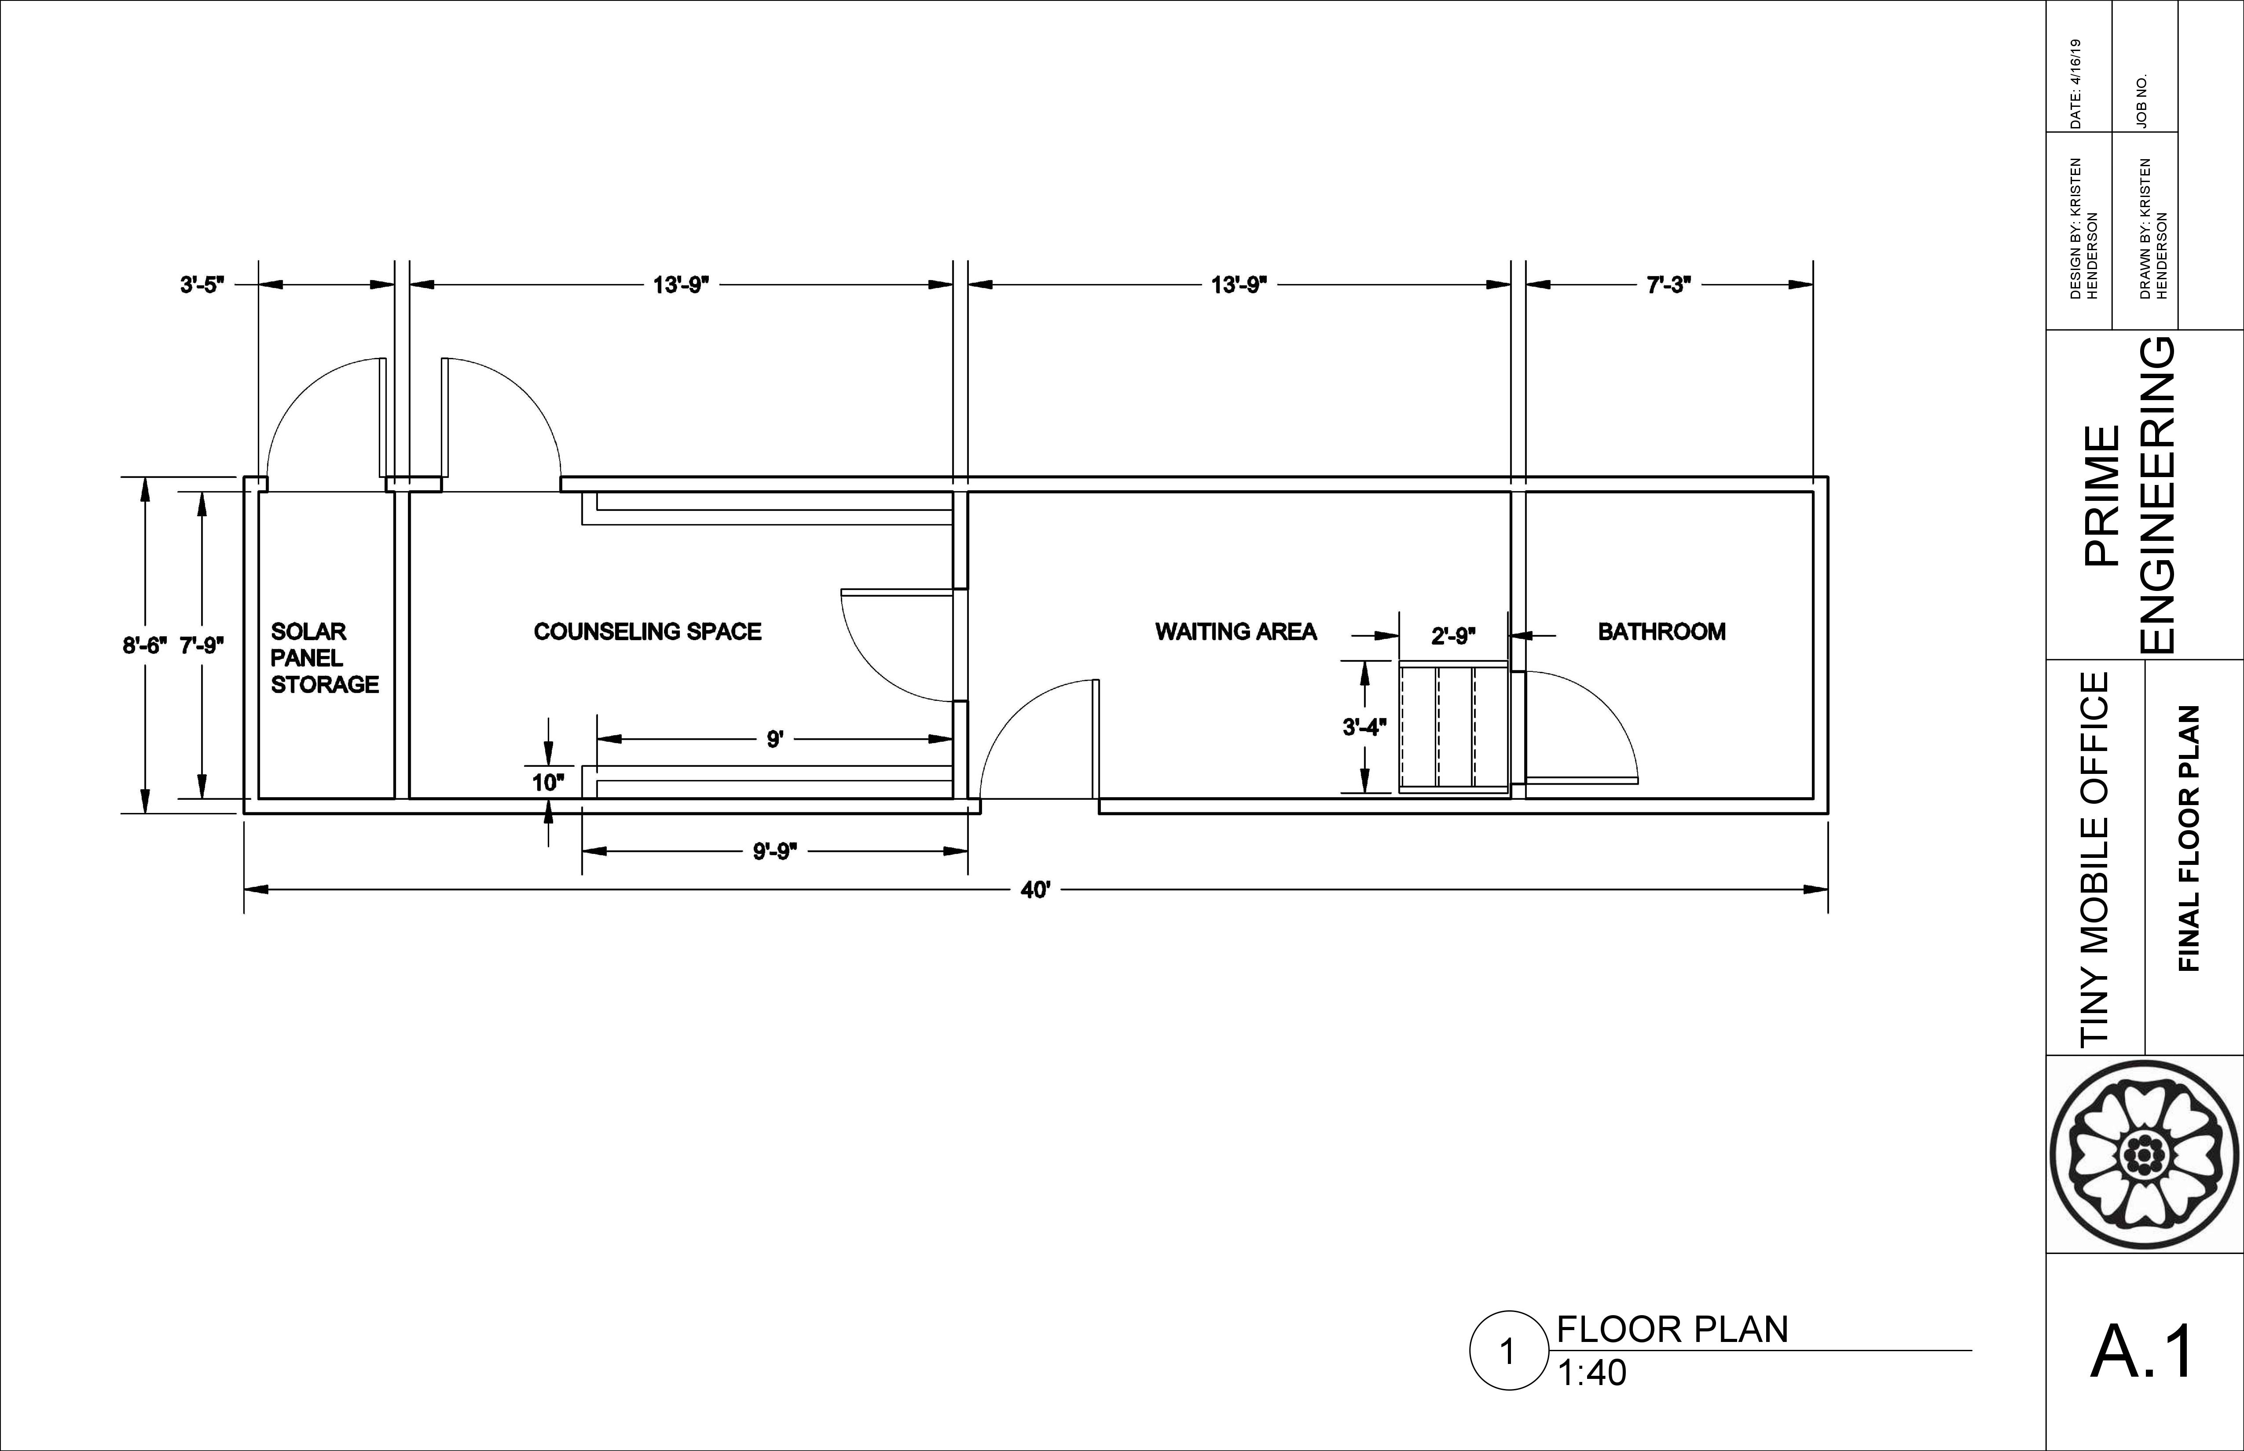

Slide 8
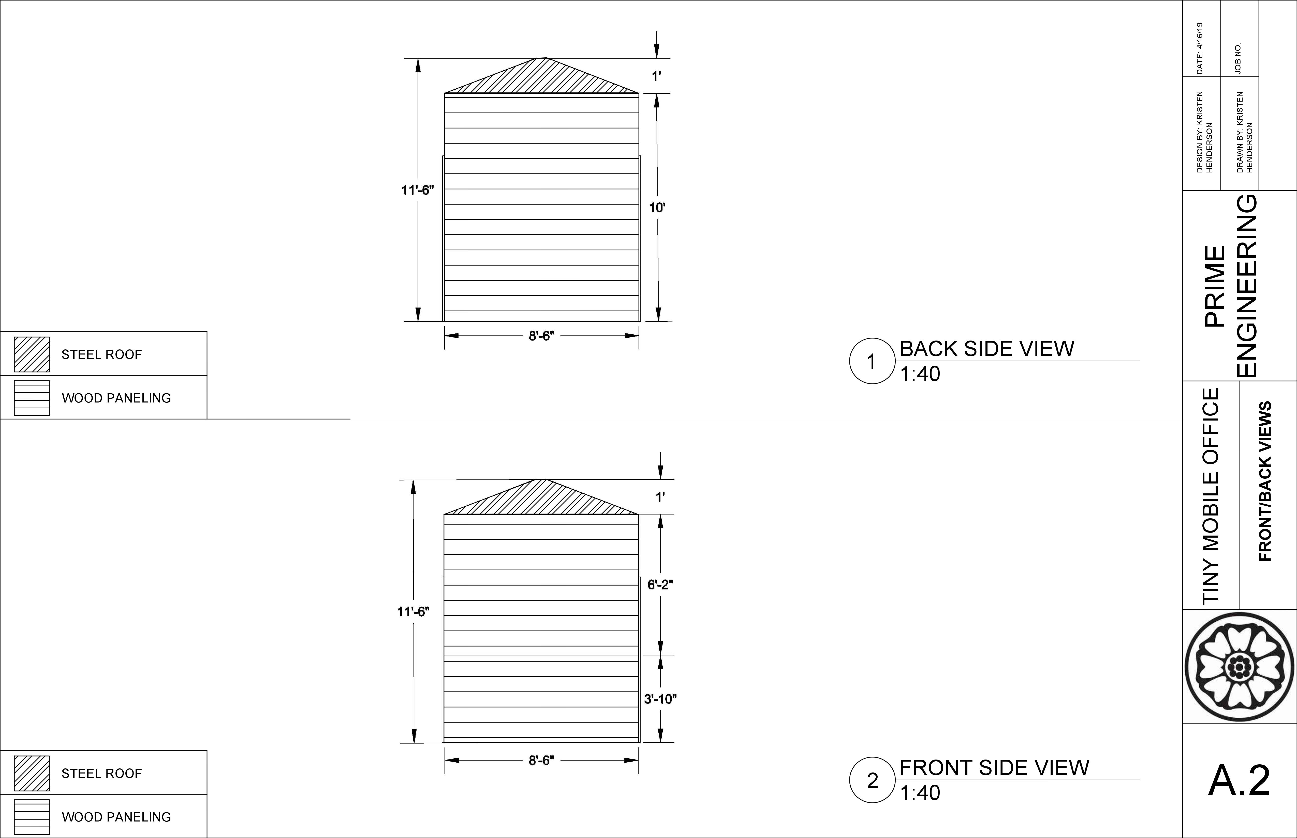

Slide 9
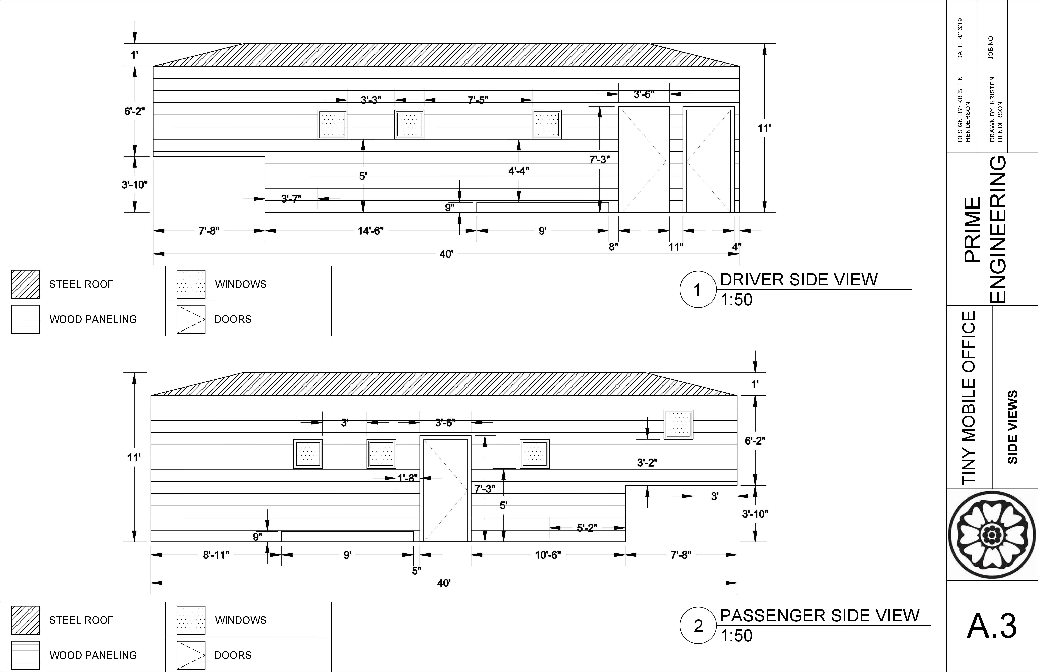

Slide 10
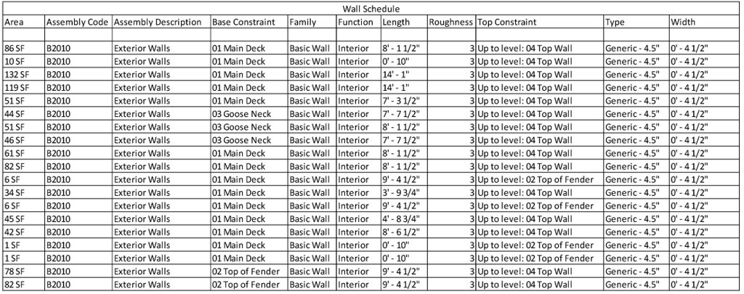

Slide 11
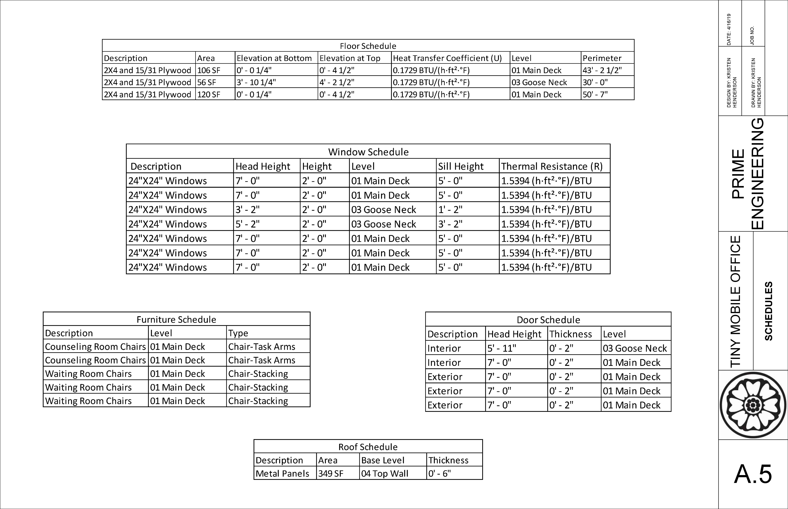

Slide 12
structural Plan

Slide 14
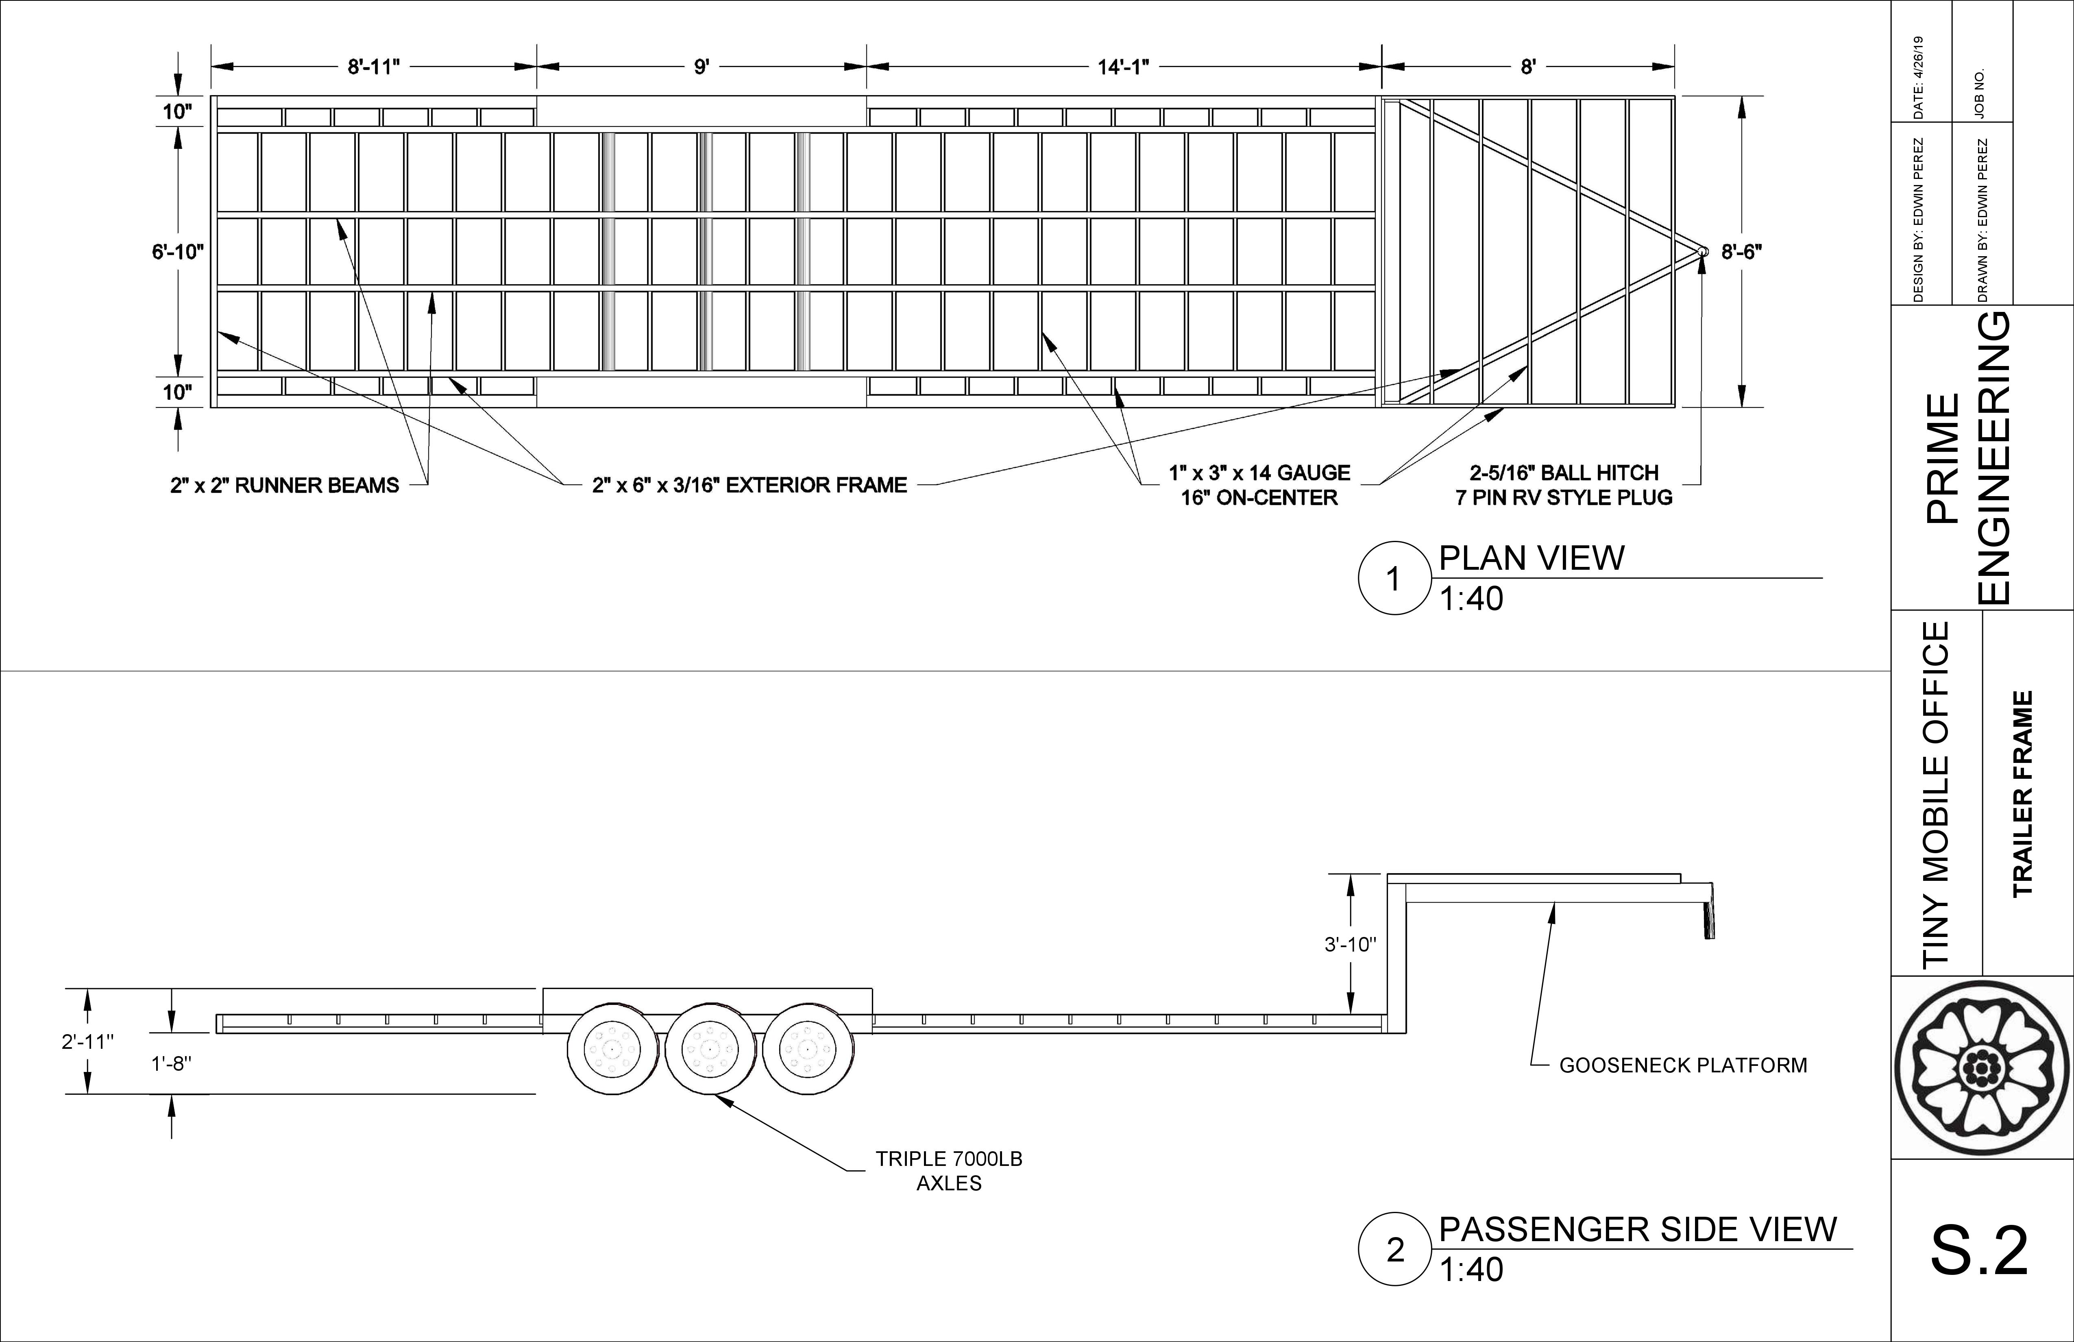

Slide 15
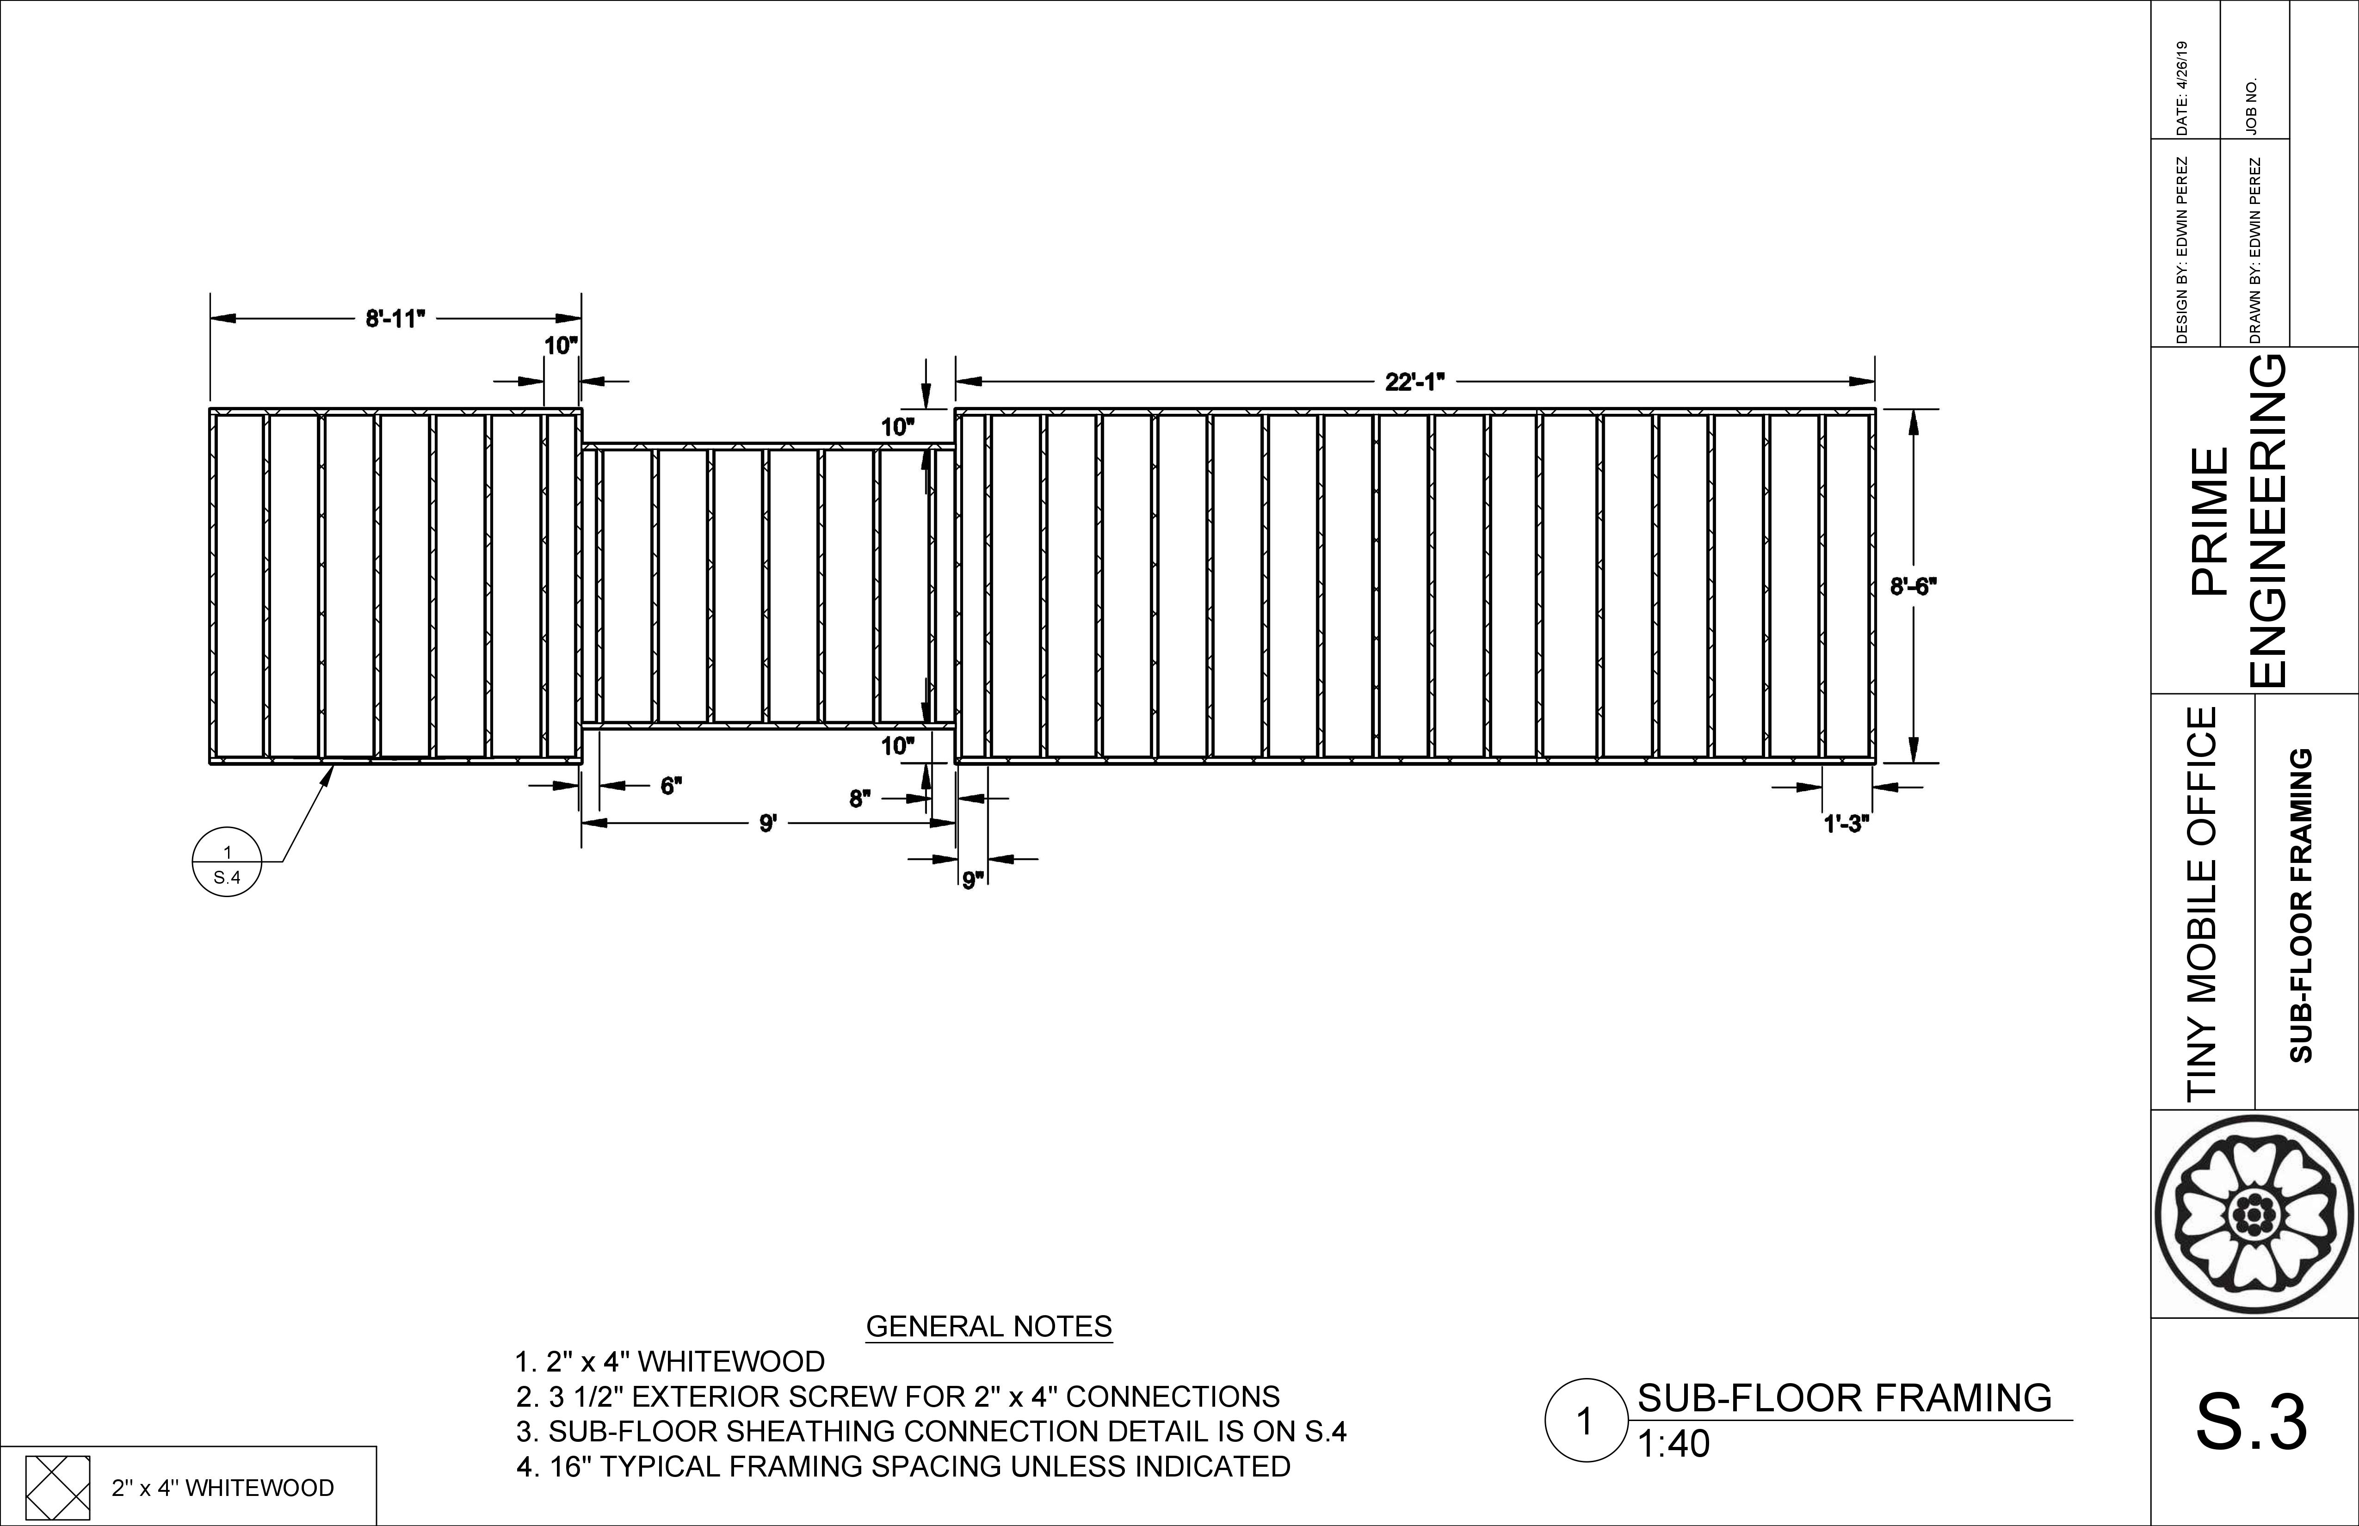

Slide 16
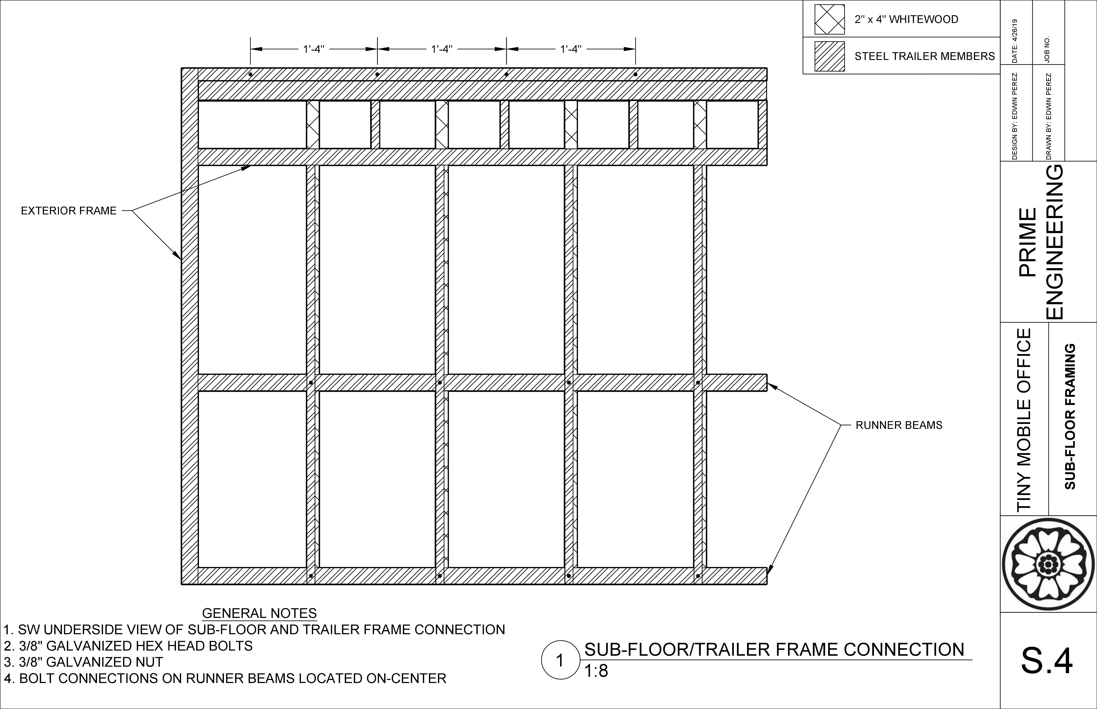

Slide 17
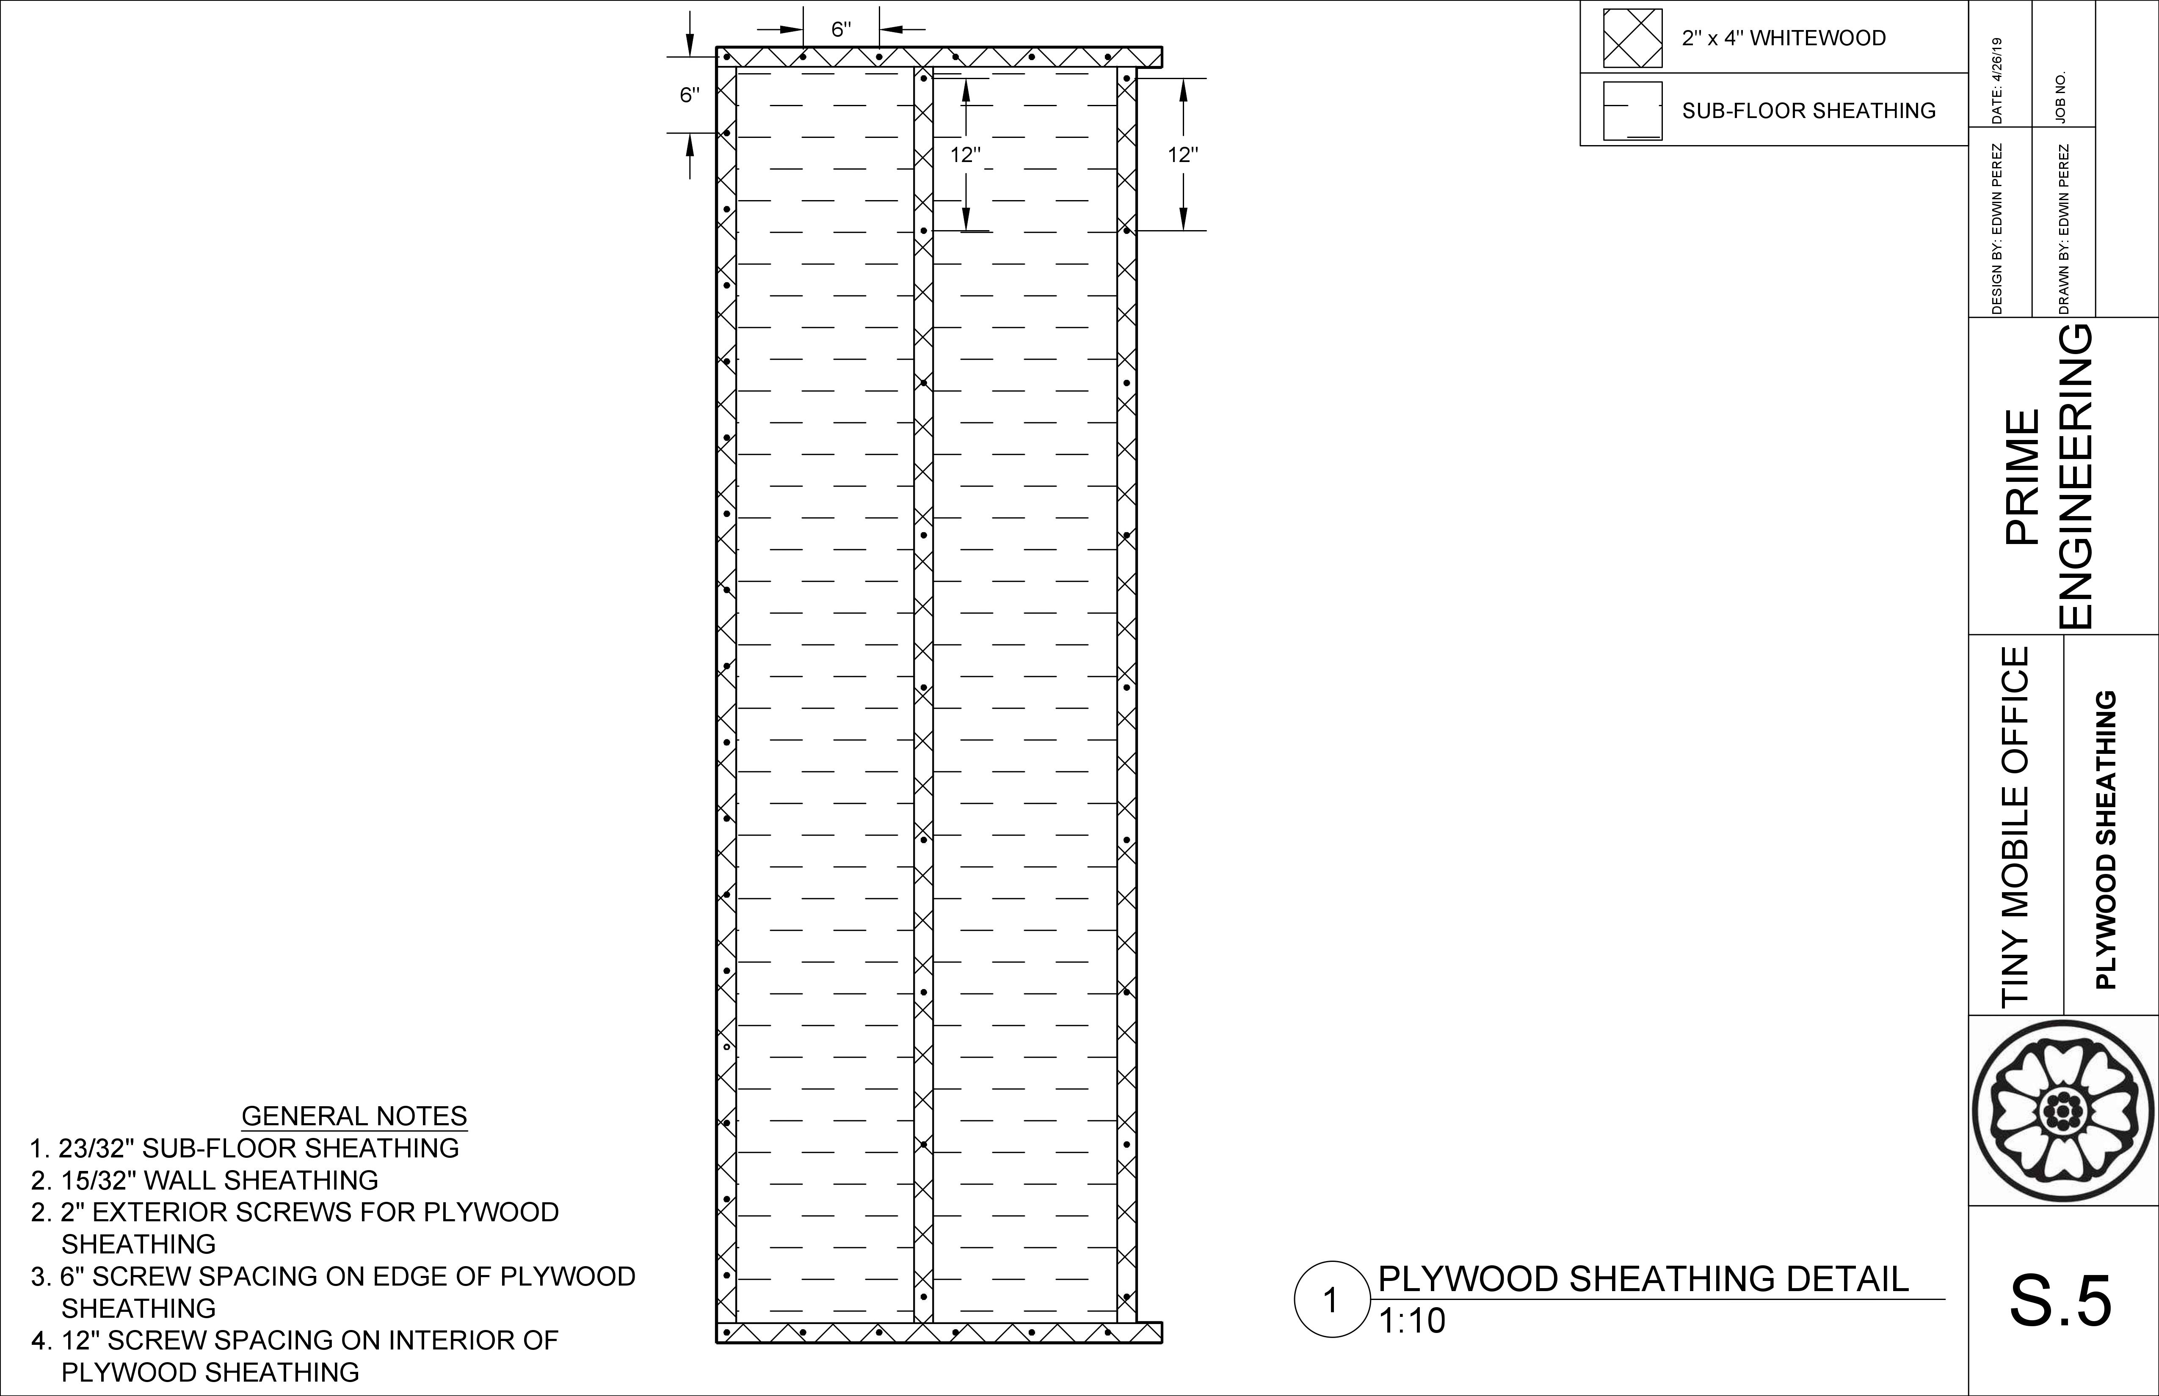

Slide 18
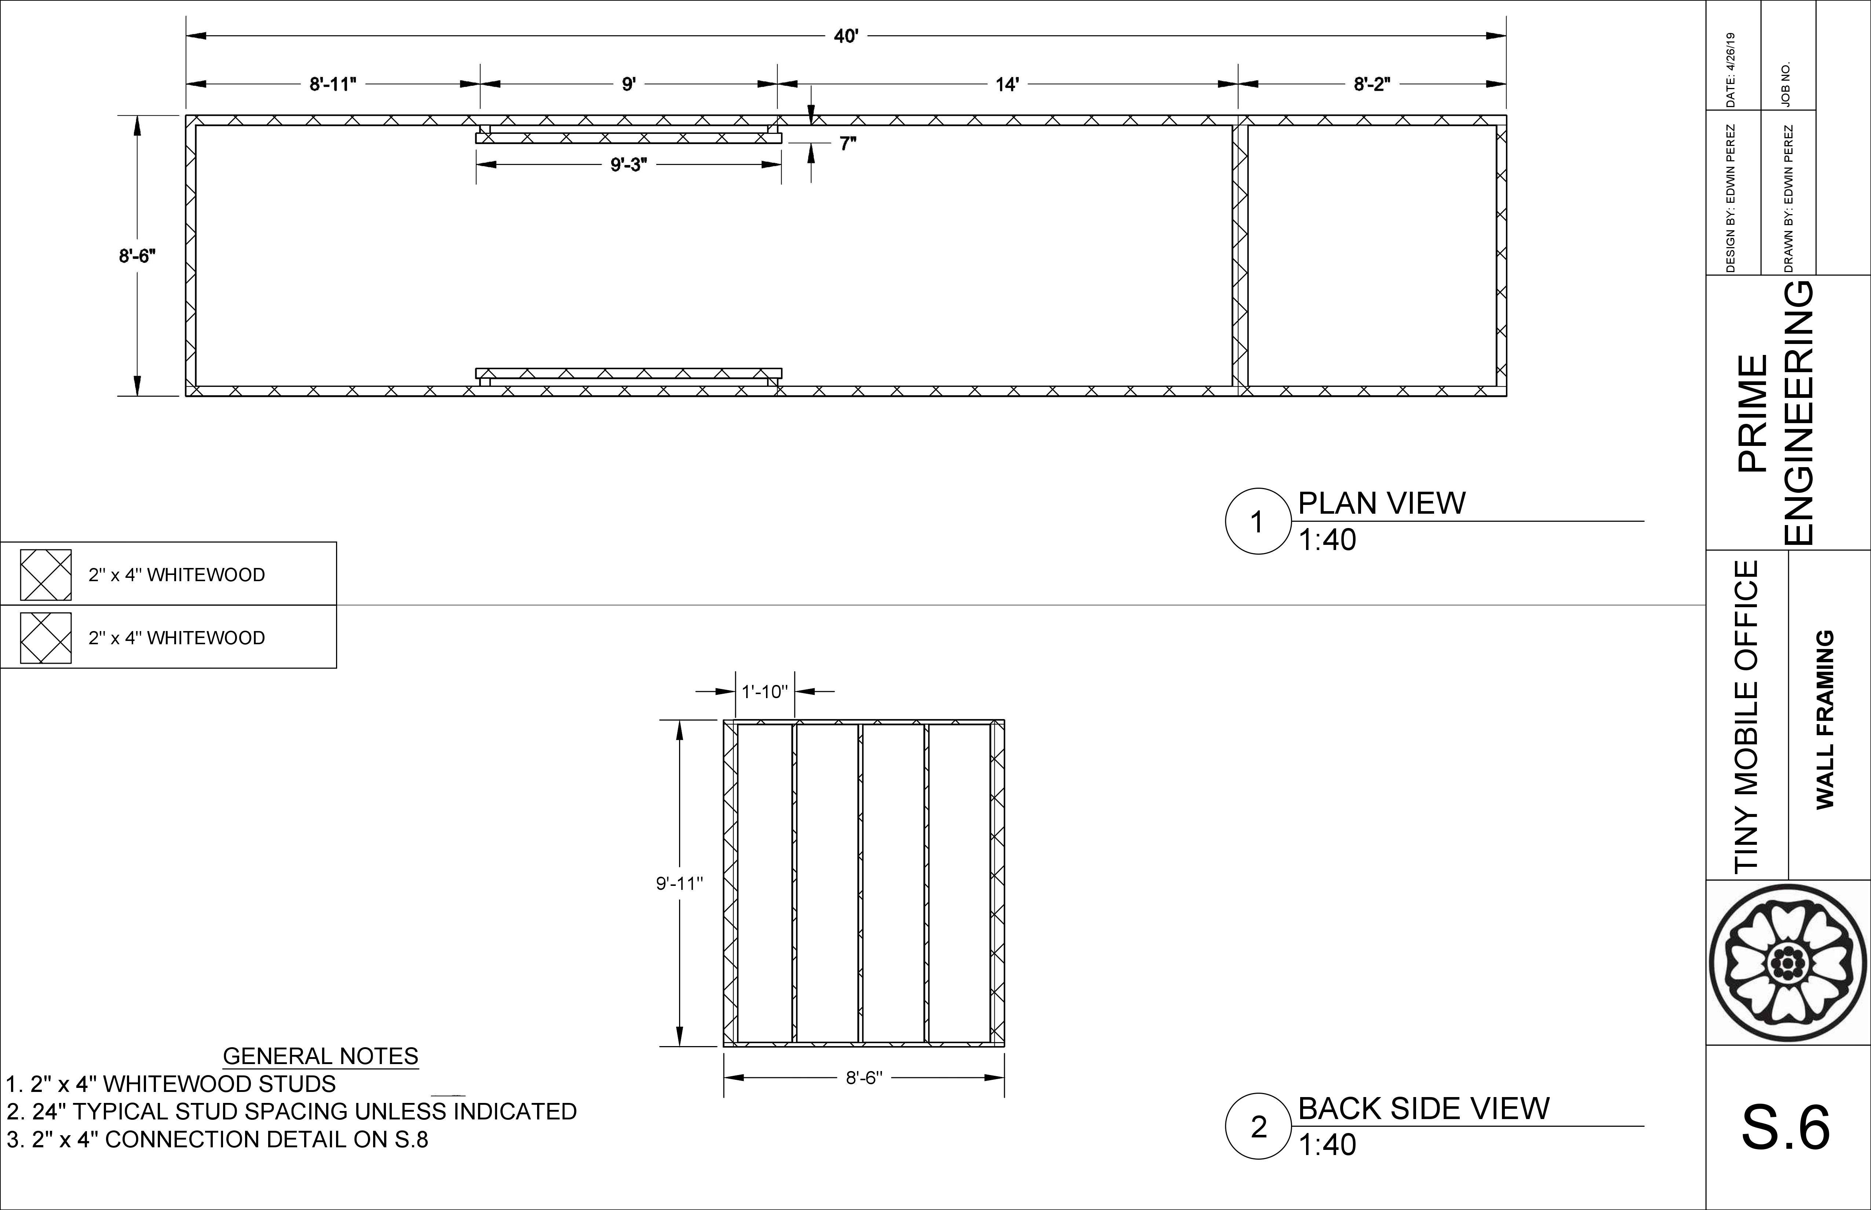

Slide 19
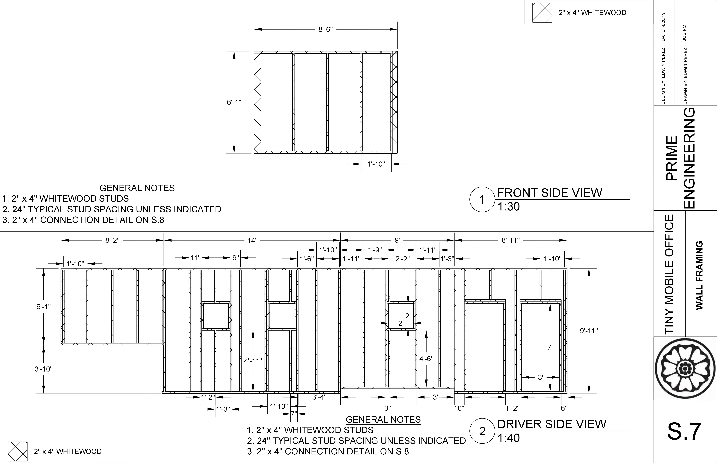

Slide 20
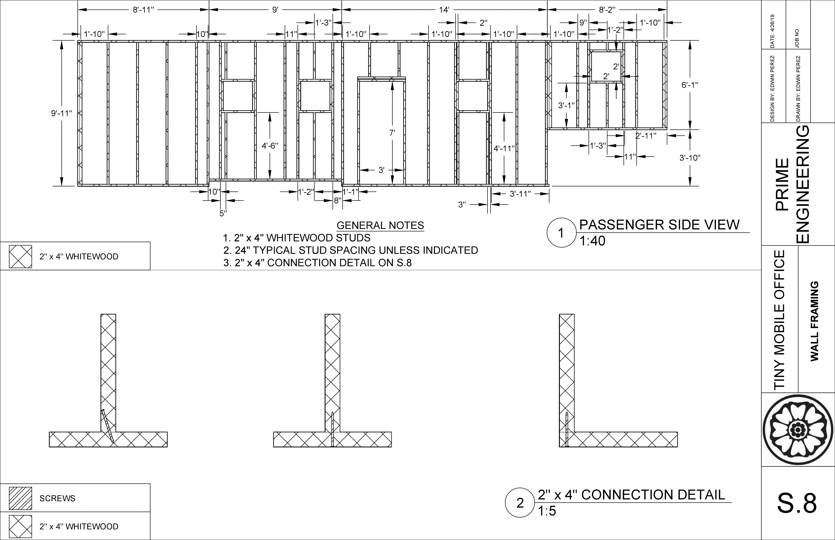

Slide 21
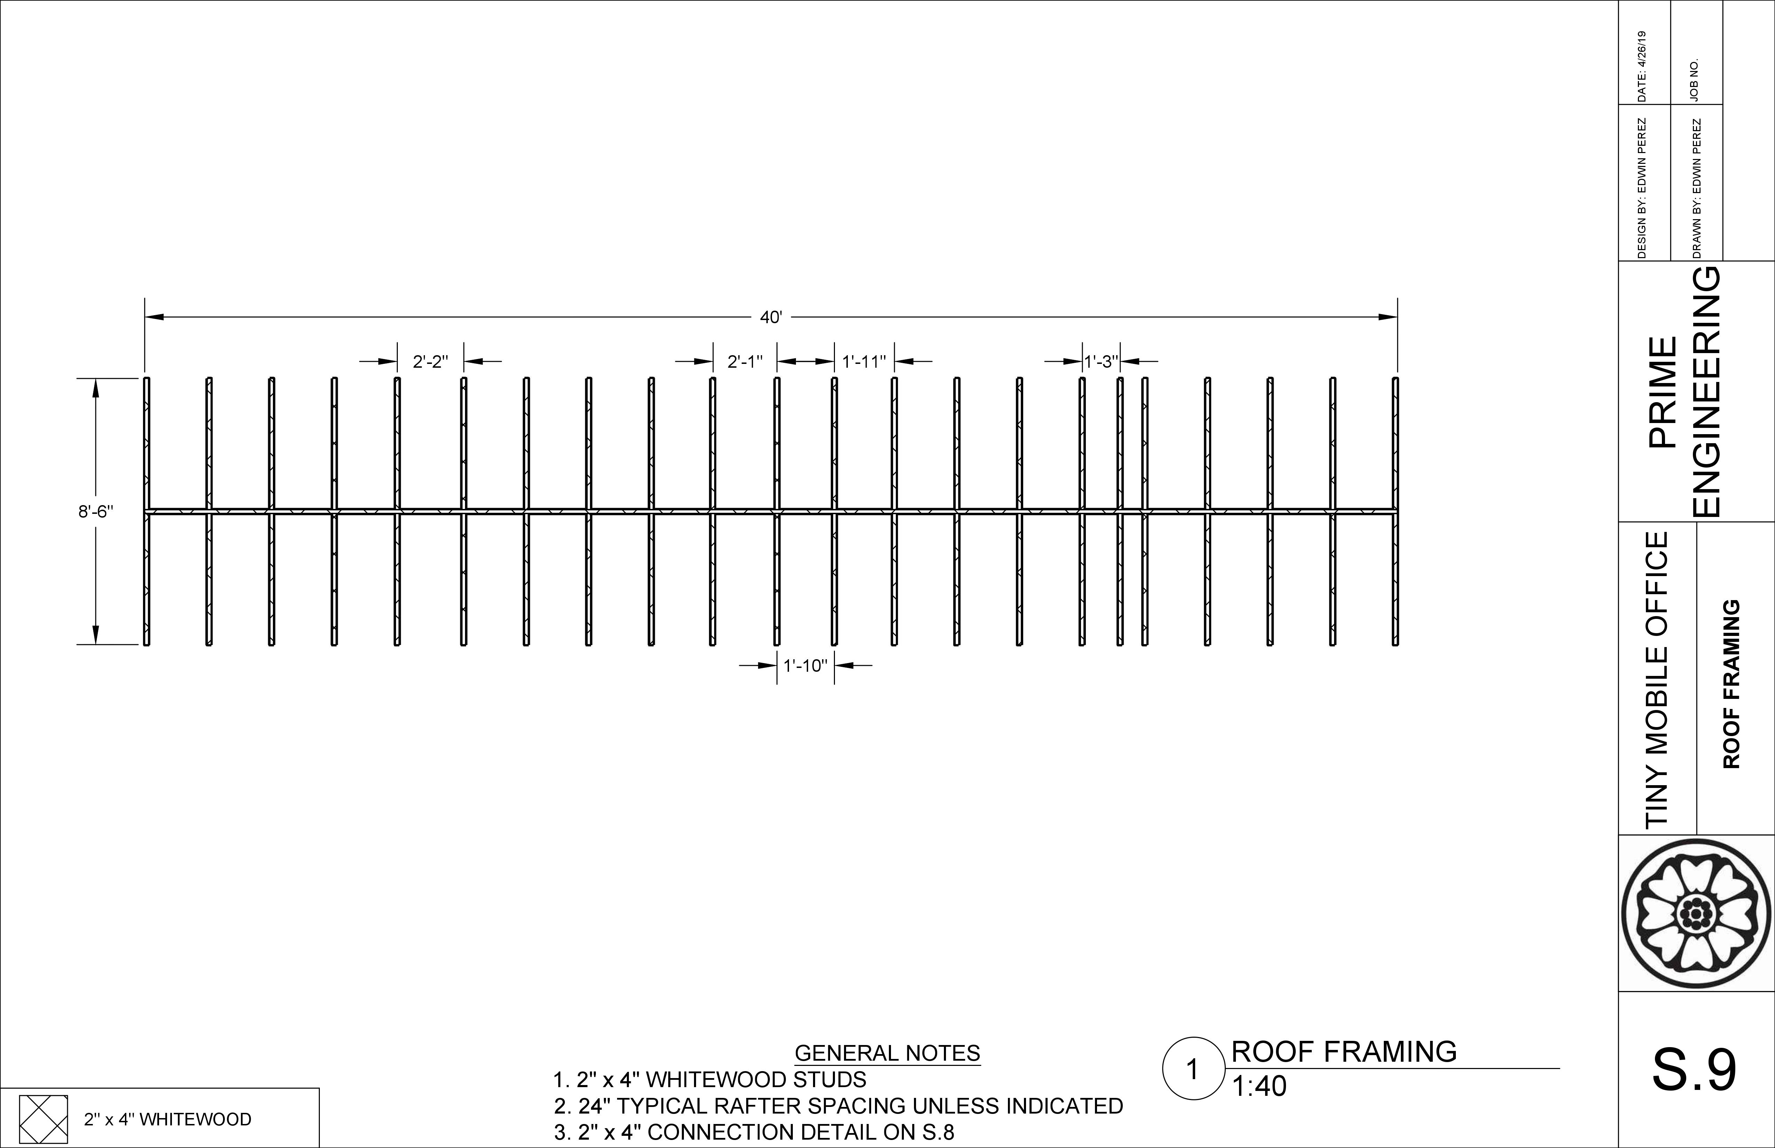

Slide 22
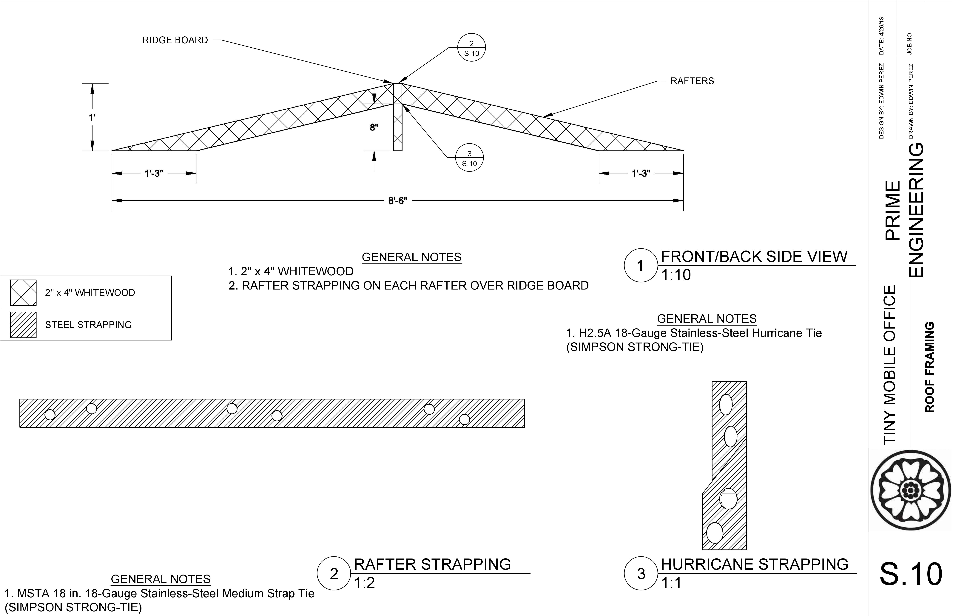

Slide 23
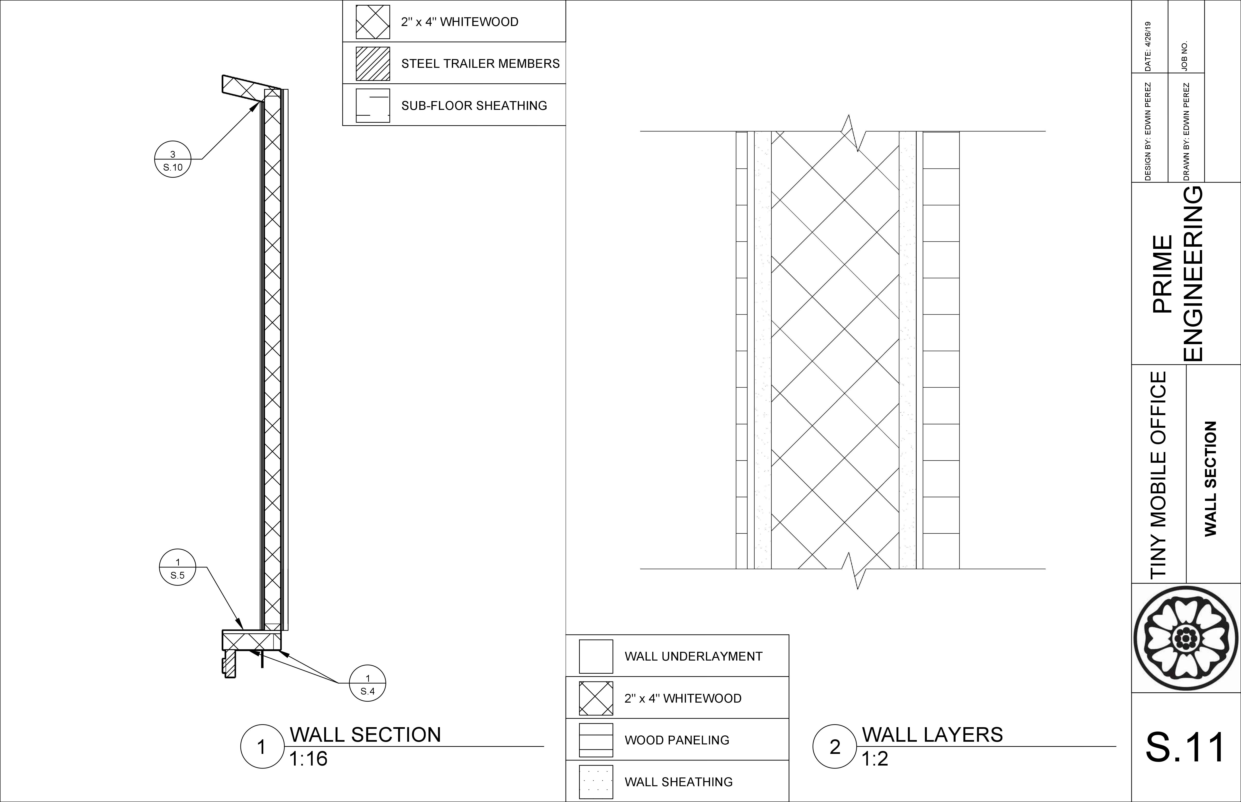
23

Slide 24
Electrical Plan

Slide 25
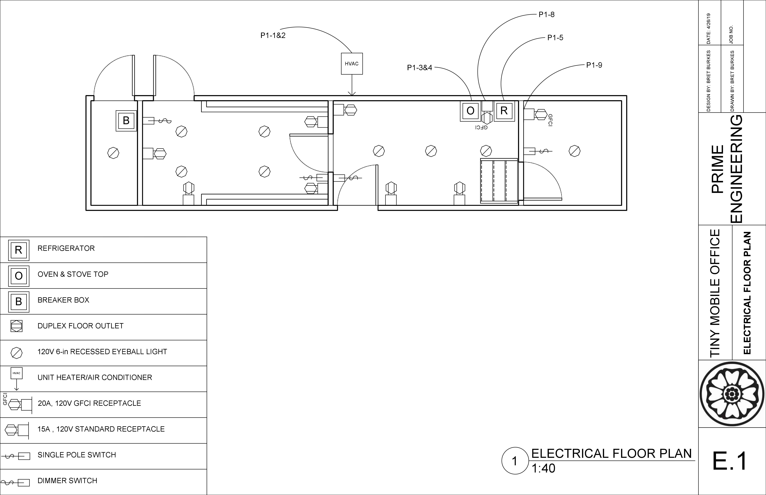

Slide 26
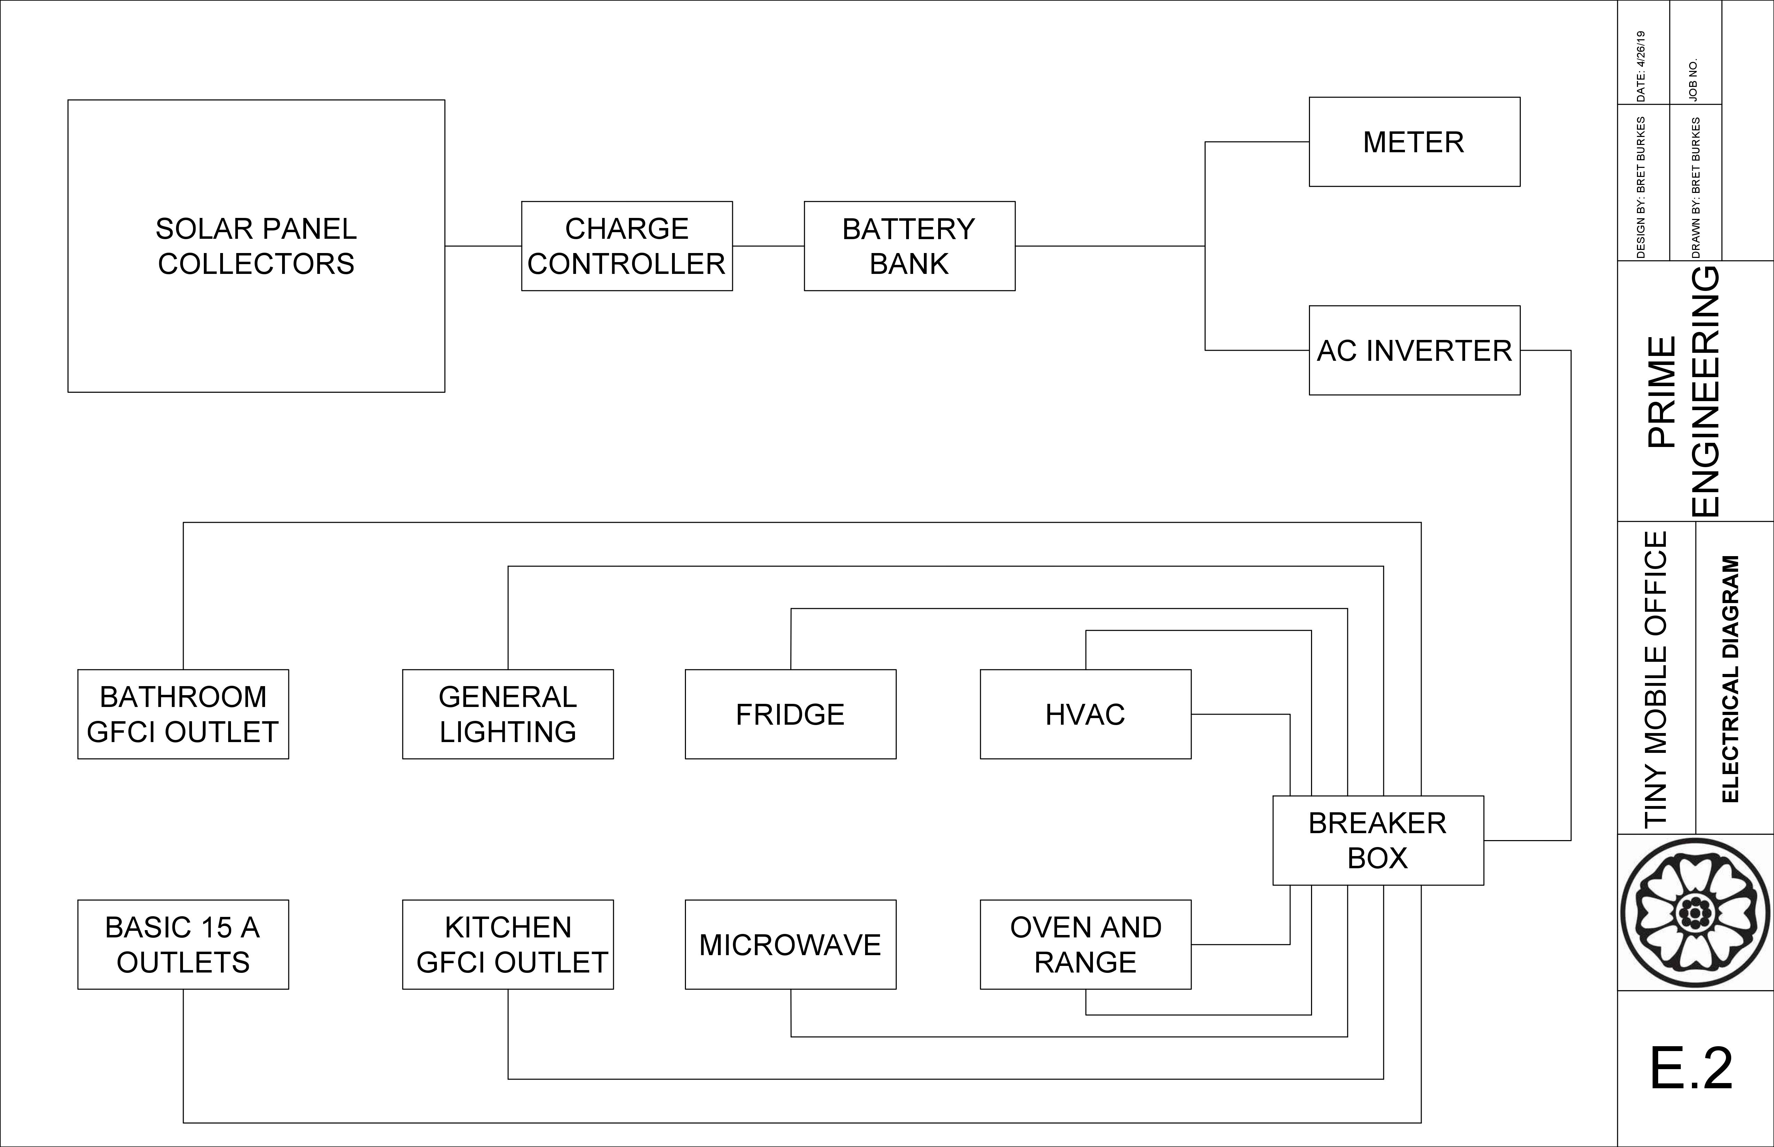

Slide 27
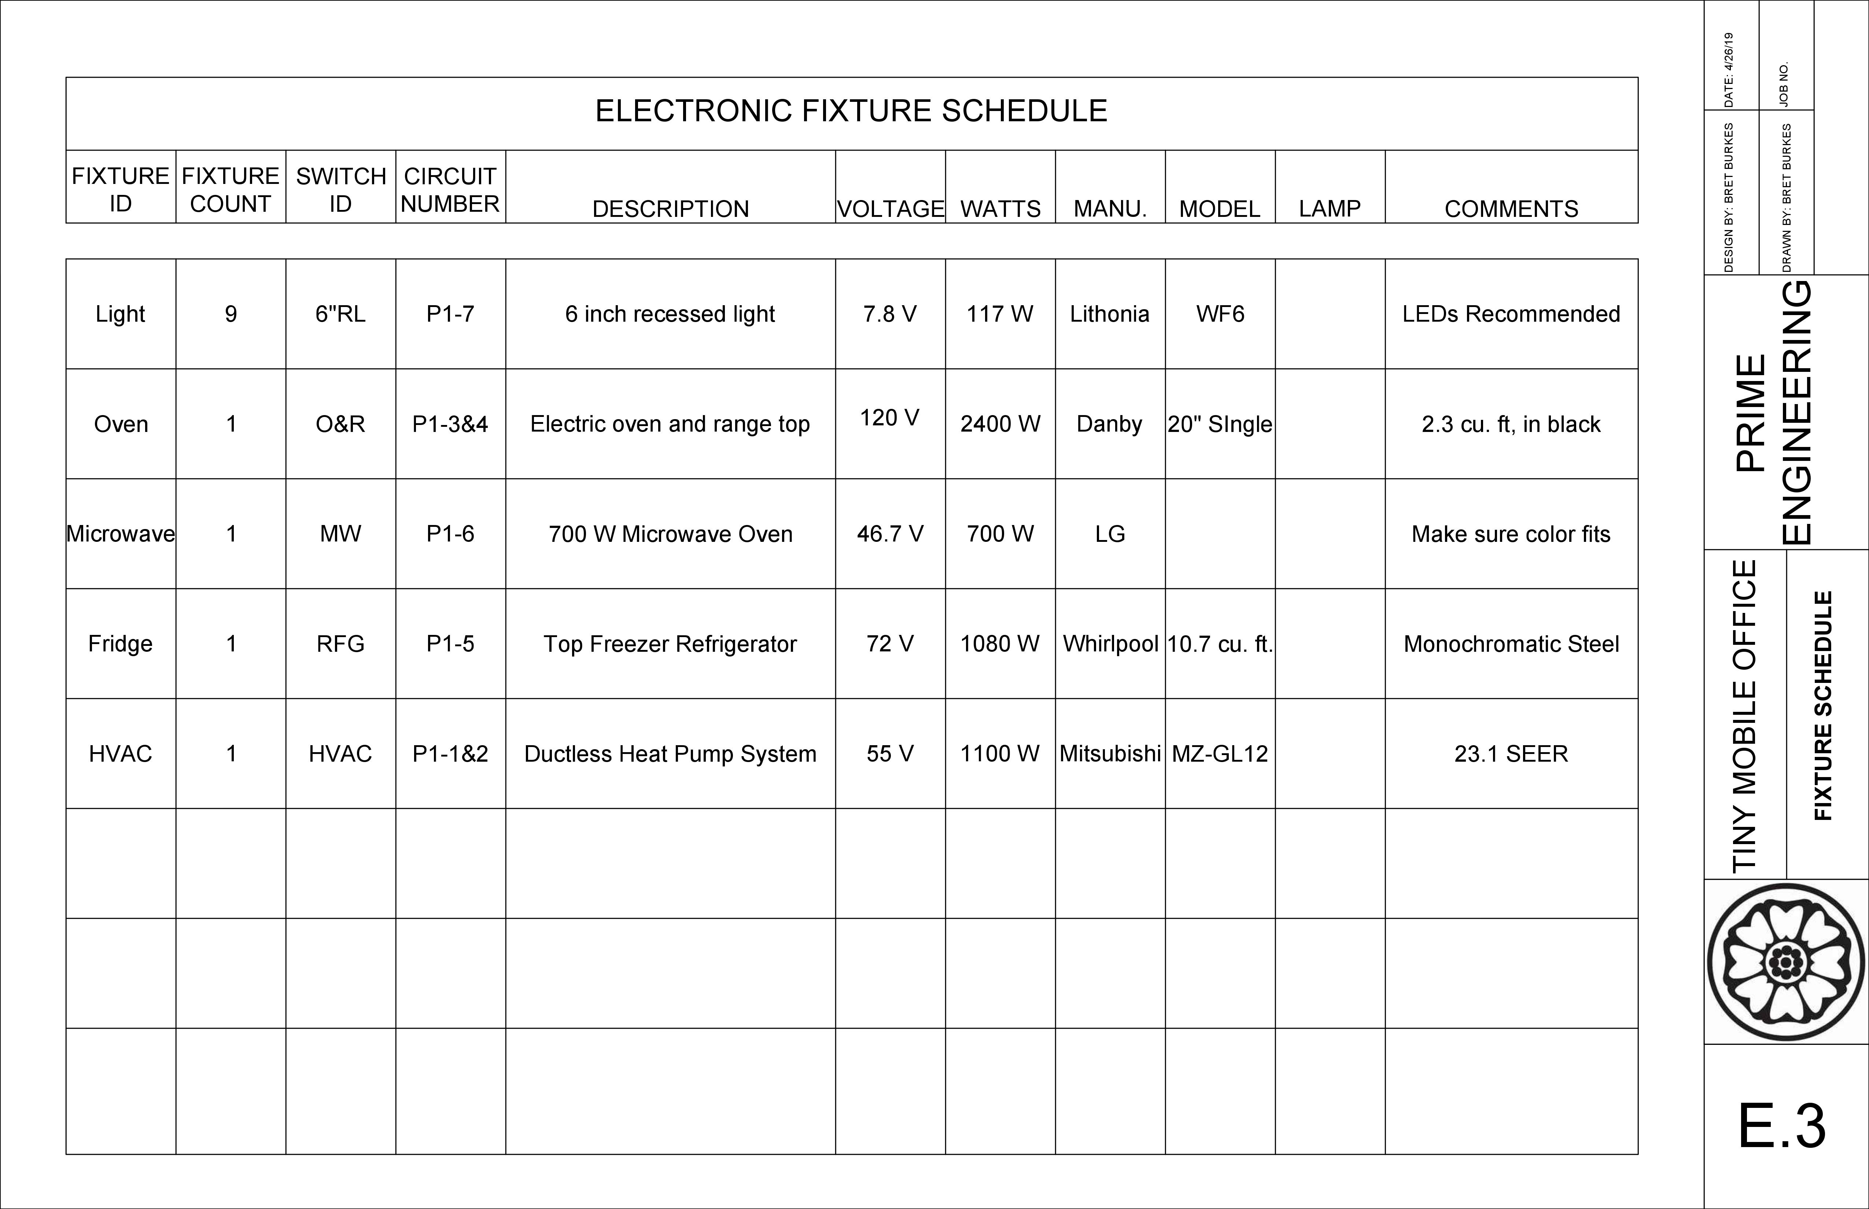

Slide 28
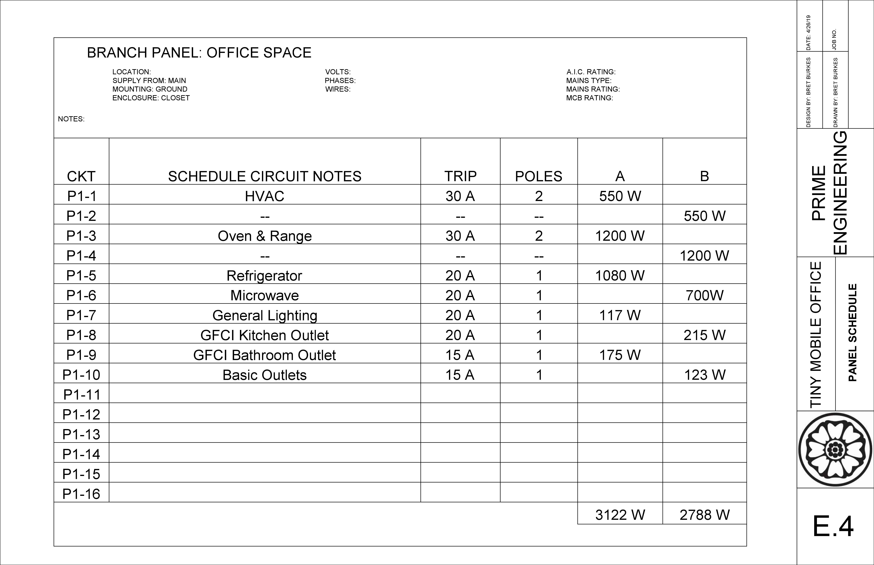

Slide 29
Plumbing Plan

Slide 30
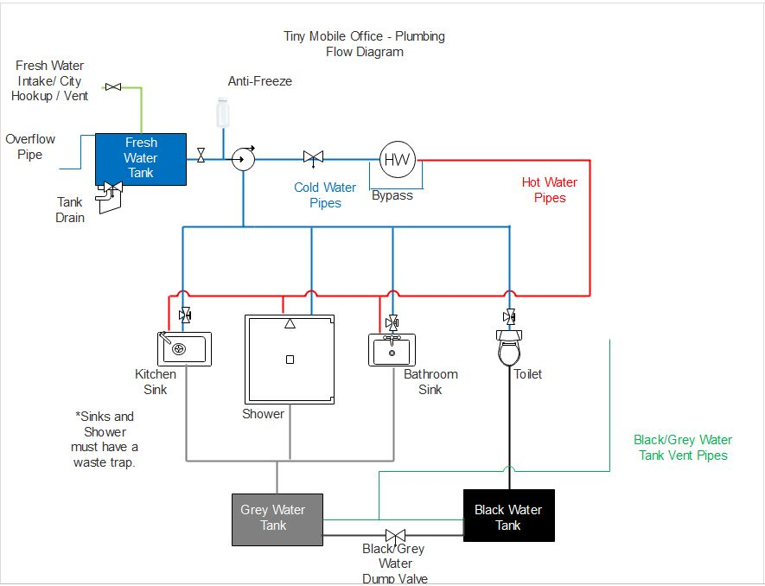
COLD AND HOT WATER PIPES - 1/2"
GREY WATER PIPES- 2"
BLACK WATER PIPES - 2"
12V WATER PUMP - 3 GPM

Slide 31
Cost of Construction Estimate

Slide 32
Table 1: Materials Cost Estimate
Materials Cost Estimate
Category | Cost
Soundproofing | $ 660.00
Trailer Frame | $ 10,176.00
Structure (includes wood frame, wall panels, doors, windows, flooring, sheathing, etc.) | $ 13,497.00
Roof (includes wood, metal, and underlayment) | $ 738.00
Solar Array | $ 12,638.00
Electrical (includes lighting and switching) | $ 297.00
Appliances (includes refrigerator, microwave, and oven) | $ 1,194.00
HVAC | $ 1,601.00
Plumbing (includes tanks, pump, pipes, water heater, hose, shower, sinks, toilet, etc.) | $ 1,739.00
Total Cost of Material | $ 42,540.00

Slide 33
Table 2: Construction Cost Estimate
Construction Cost Estimate
Category | Cost
Electrical | $ 1,500.00
Plumbing | $ 1,500.00
Remaining Construction | $ 3,000.00
Total Cost of Construction | $6,000.00
Table 3: Estimated Total Project Cost Estimate
Estimated Total Cost of Project
Category | Cost
Total Cost of Material | $ 42,540.00
Total Cost of Construction | $ 6,000.00
Total Cost of Project | $ 48,540.00

Slide 34
Cost of engineering services
Table 4: Original Estimated Cost of Engineering Services
 | Classification | Hours | Rate/Hour | Cost
1.0 Personnel | Senior Engineer | 102 | 194 | $19,788
 | Engineer | 356 | 98 | $34,888
 | Intern | 120 | 42 | $5,040
 | Project Manager | 250 | 129 | $32,250
 |  |  | Total Cost | $91,966

Slide 35
Cost of engineering services
Table 5: Actual Cost of Engineering Services
 | Classification | Hours | Rate/Hour | Cost
1.0 Personnel | Senior Engineer | 47 | 194 | $9,118
 | Engineer | 163 | 98 | $15,974
 | Intern | 55 | 42 | $2,310
 | Project Manager | 114 | 129 | $14,706
 |  |  | Total Cost | $42,108

Slide 36
Table 6: Comparison of Estimated vs Actual Hours
 | Staff (hrs) |  |  |  | Task Total | Commenced Total
Project Tasks | ENG | SENG | INT | PM
1.0 Preliminary Layout | 129 | 13 | 39 | 41 | 222 | 101
1.1 Design Constraints & Criteria | 17 | 2 | 6 | 8
1.2 Architectural Layout | 20 | 2 | 8 | 7
1.3 Electrical Layout | 29 | 4 | 7 | 7
1.4 Plumbing Layout | 16 | 1 | 5 | 7
1.5 Structural Layout | 19 | 1 | 7 | 6
1.6 Mechanical Layout | 28 | 3 | 6 | 6
2.0 Design Plans | 138 | 47 | 63 | 7 | 255 | 156
2.1 Architectural Plan | 38 | 12 | 20 | 2
2.2 Plumbing Plan | 18 | 5 | 10 | 1
2.3 Electrical Plan | 20 | 7 | 10 | 1
2.4 Structural Plan | 45 | 18 | 14 | 2
2.5 Mechanical Plan | 17 | 5 | 9 | 1
3.0 Cost Estimate | 27 | 13 | 9 | 42 | 91 | 44
3.1 Materials Cost | 15 | 6 | 4 | 15
3.2 Construction Cost | 12 | 7 | 5 | 27
4.0 Project Management | 62 | 29 | 9 | 160 | 260 | 78
4.1 Scheduling | 42 | 20 | 5 | 110
4.1.1 Preliminary Design | 10 | 4 | 2 | 28
4.1.2 Design Plans | 15 | 5 | 1 | 14
4.1.3 Cost Estimate | 8 | 6 | 1 | 32
4.1.4 Final Proposal/Final Presentation | 9 | 5 | 1 | 36
4.2 Deliverables | 0 | 4 | 1 | 22
4.3 Meetings | 20 | 5 | 3 | 28
Staff Total | 356 | 102 | 120 | 250 | 828 | 379

Slide 37
Gantt chart

Slide 38
Project Milestones
Table 7: Project Milestone Expected Completion vs. Actual Completion Dates
Milestone | Expected Date of Completion | Actual Date of Completion
Preliminary Plans | 1/29/2019 | 1/29/2019
30% Submittal | 2/12/2019 | 2/11/2019
60% Submittal | 3/12/2019 | 3/11/2019
Final Architectural Plan | 4/23/2019 | 4/12/2019
Final Structural Plan | 4/23/2019 | 4/15/2019
90% Submittal | 4/16/2019 | 4/16/2019
Final Submittal | 5/7/2019

Slide 39
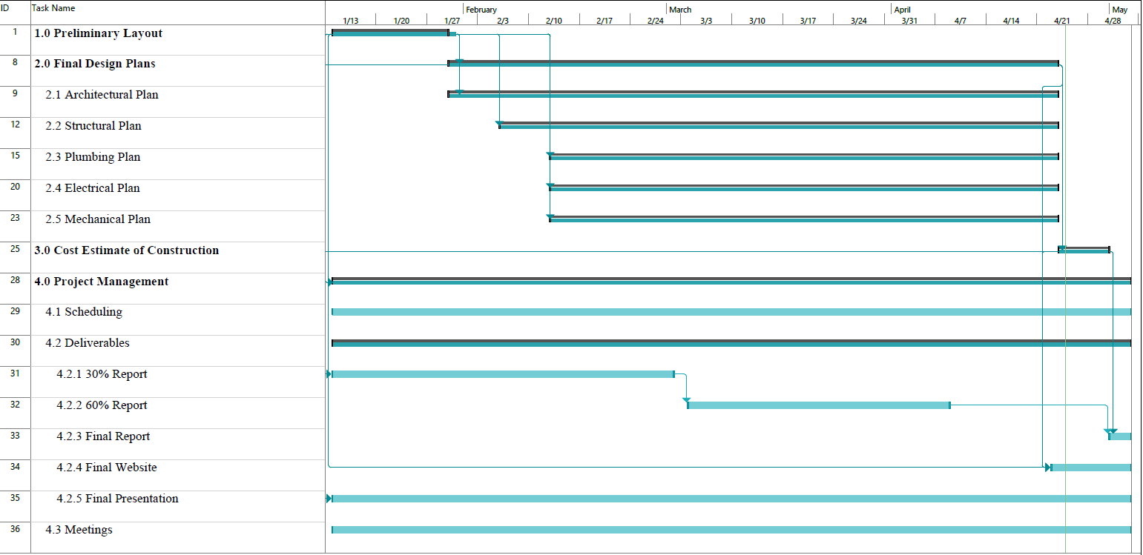
Figure 1: Original Gantt Chart

Slide 40
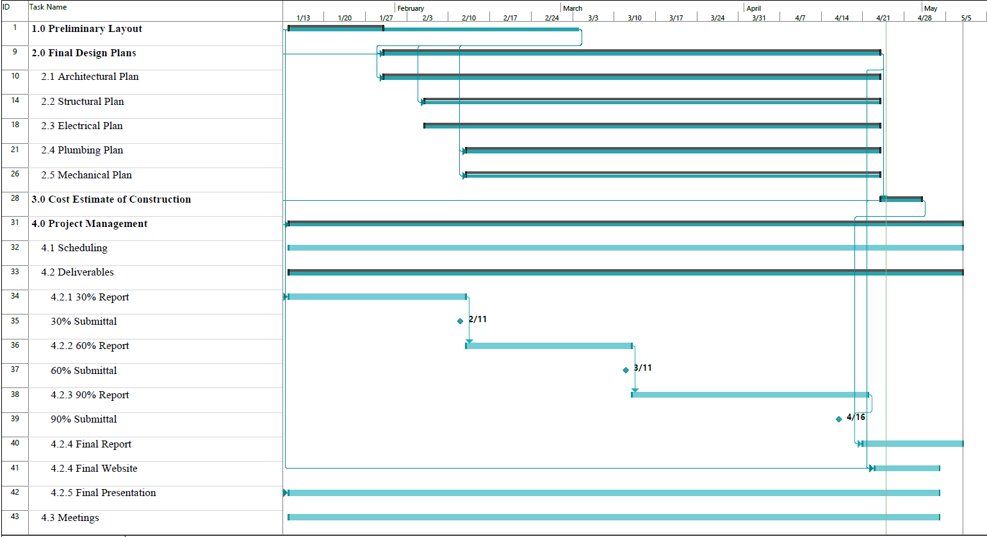
Figure 2: Updated Gantt Chart

Slide 41
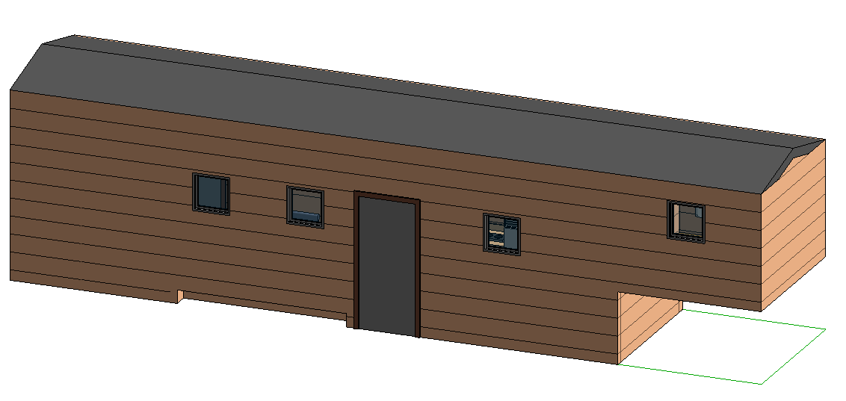
Conclusion
Met Fully Electric Recommendation
Met $50,000 Budget with Total Project Cost at $48,540
Met Office Space Recommendations
Met Low Waste/Efficient Plumbing System
Figure 4: Rendering Floor Plan
Figure 3: Rendering 3D View

